Slide 1
Regulering, standarder og beredskabsplaner
Generelle koncepter anvendt I flere hovedforløb
Michael Stausholm
Principal Security Architect

Slide 2
Agenda
Tidspunkt | Emne | Format
8.30-8.45 | Introduktion til “Cyber lovgivning” Introduktion til standarder | Præsentation
8.45-9.30 | Lovgivning GDPR og NIS-2 RED DA og CRA | Præsentation
9.30-10.15 | Pause + Øvelse / case | Workshop
10.15-11.15 | Standarder og best practices 27000-familien D-mærket, CIS-18 og OWASP Produkt standarderne | Præsentation
11.15-12.00 | Pause + Øvelse / case | Workshop
12.00-13.00 | Frokost
13.00-13.30 | Beredskabsplaner | Præsentation
13.30-13.45 | Øvelse / case | Workshop
13.45-14.00 | Closing remarks | Discussion

Slide 3
Relation til målepinde:
IT/CS H2: 1. Lærlingen har kendskab til formålet med kan beskrive gængse sikkerhedsstandarder formålet med(fx ISO 27001 og ISO 27002) og har kendskab relevante organisationer som for eksempel Center for cybersikkerhed og Center for Internet security (CIS)
IT/CS H2: 2. Lærlingen kan forklare begreberne compliance og regulering samt værdien af en beredskabsplan.
IT/CS H3: 2. Lærlingen kan udarbejde en risikovurdering på en mellemstor virksomheds aktiver og processer og implementere en CIS kontrol og mitigerings tiltag.
IT/CS H4: 1. Lærlingen kan forstå GDPR og dets implikationer for informationssikkerhed samt etiske aspekter indenfor cybersikkerhed.
IT/CS H4: 2. Lærlingen kan beskrive SOC 2 og relationerne til gængse sikkerhedsstandarder (fx ISO 27001).
IT/CS H4: 3. Lærlingen kan gennemføre en compliance Review herunder evaluere tredjeparts compliance og sikkerhed (underleverandører).
IT/CS H5: 2. Lærlingen kan anvende best practices fra standarder som OWASP og CVE for at forbedre sårbarhedshåndtering.
Notes:
https://eur-lex.europa.eu/eli/dir/2014/53/2024-12-28

Slide 4
Yderligere info/links:
https://www.ds.dk/da/download/ds-inf-21007-2024 Overblik over cybersikkerheds lovgivning
https://www.ds.dk/da/download/ds-pas-2600-2021 Overblik over cybersikkerheds standarder (primært produkt orienteret)
NIS2 Direktivet (http://data.europa.eu/eli/dir/2022/2555/oj)
Vejledning fra SAMSIK (https://samsik.dk/nis2/nis-2-vejledninger/)
D-mærket (https://www.d-maerket.dk/)
ISO standarderne (f.eks ISO 27001) kan købes ved Dansk Standard (https://www.ds.dk/da)
CIS18 (https://www.cisecurity.org/controls/cis-controls-list)
OWASP (Mange projekter) f.eks:
https://owasp.org/www-project-top-ten/ - Top 10 sårbarheder i web apps
https://owasp.org/www-project-juice-shop/ - Juice shop, Sårbar web app
Notes:
https://eur-lex.europa.eu/eli/dir/2014/53/2024-12-28

Slide 5
Cyber lovgivning og standarder
EN introduktion

Slide 6
EU wants to improve cybersecurity
2018: GDPR + NIS Directive
2019: Cyber Security Act
2022: Digital Services Act + Digital Markets Act
2024: Product Liability Directive + General Product Safety Regulation + NIS 2 Directive + DORA + Cyber Solidarity Act + AI Act
2025: Radio Equipment Directive Delegated Act
2027: Cyber Resilience Act + Machinery Directive
In addition: Medico, Automotives and other special legislation

Slide 7
EU lovgivning
Direktiver og forordninger
Direktiver skal implementeres i national lov
Forordninger er direkte gældende
Fordele og ulemper ved begge typer
Direktiver giver plads til nationale hensyn
Direktiver skaber forskellige krav i EU
Love kan være orienteret omkring produkter eller organisationer

Slide 8
Sammenspil med standarder
Love skal overholdes
Standarder er altid frivillige* at bruge
* Nogle love tillader standarder som dokumentation

Slide 9

CE-Marking
Self declaration of “conforming to EU regulation”:
Self evaluate what regulation covers the product
Must maintain technical documentation
Market surveillance may review technical documentation
Requirements for technical documentation may differ:
Self assessment
Self assessment based on a harmonized standard
External review by Notified body
Certification

Slide 10
Hvad er en standard?
”Et dokument med regler, vejledninger eller karakteristika for et objekt eller aktivitet”
”Rigtige” standarder kommer fra en ”anerkendt” standardiserings organisation, f.eks. ISO/IEC, CEN/CLC, ETSI, ITU-T
Et stort fokus på konsensus, demokrati og kvalitet ☺
Og et meget langsommeligt bureaukrati ☹
Et veletableret økosystem omkring ”rigtige” standarder
Standarder for hvordan man skal teste efter standard
Og standarder for hvordan man kontrollerer dem som tester

Slide 11
Best practices
Mange andre resourcer, f.eks IETF, OWASP og CIS(-18)
Indholdsmæssigt kan de sagtens være på niveau
Typisk foran på ny teknologi ☺
Hurtigt at lave ændringer ☺
Ingen garantier for stabilitet, demokrati ol. ☹

Slide 12
Lovgivning

Slide 13
GDPR – Persondata-forordningen
En kaotisk ankomst 21/5 2018:
“Beskyt persondata eller få en mega bøde”
Virksomheder blev skræmt til at gøre noget
Mangel på kompetent vejledning
Cybersikkerhed = persondata/GDPR

Slide 14
GDPR – Hvad skal man faktisk?
Holde styr på hvad man har af persondata
Behandle persondata “fornuftigt”
Kun opsamle/behandle det man faktisk har brug for
Informere brugerne (data subjekterne) og få deres accept
“Right to be forgotten”
Passe på dataene
Dokumentere ovenstående er overholdt

Slide 15
GDPR – Et par detaljer
Når man laver risikovurdering, skal man tage udgangspunkt i datasubjektet
Hvis man har et datalæk, skal det indberettes indenfor 72 timer
Man skal have styr på sine underleverandører
Databehandler aftaler og tilsyn
Privacy by design

Slide 16
GDPR – Hvad er en person-oplysning?
Patientjournal
Timesedler / tidsregistrering
Kildekoden til MitID
Loggen på DMI’s WebApp
Registrering af en virksomheds el-forbrug
Bud på gråzoner?

Slide 17
5-min Pause

Slide 18

NIS Directive – Critical Infrastructure
NIS directive of 2016:
Protect critical infrastructure wrt. ”cybersecurity”
Different requirement for each country and sector:
Energy, Transportation, Water, etc.
Never really a success
Didn’t appear to change anything
GDPR?

Slide 19
NIS 2 - What's new?
Larger scope:
Listed in annex 1 & 2 (e.g waste water, food industry, etc.)
Medium size (larger than 50 employees or turnover >10 M€)
Unless:
National security and law enforcement is exempt
But: Sole supplier, affecting health, cross boundary, etc.
Size doesn’t matter
Unless micro company...
Notes:
We’ll look at the actual requirements later

Slide 20
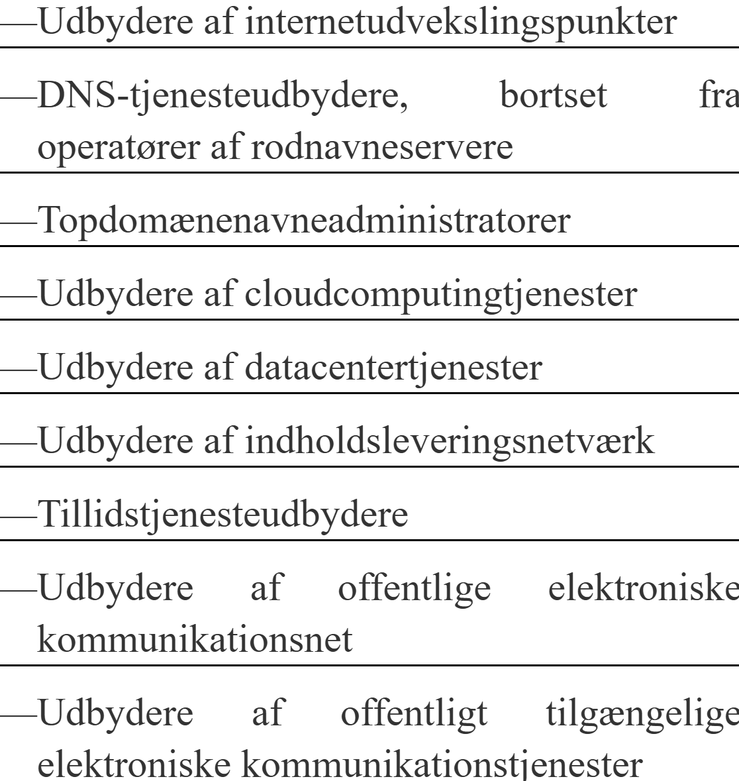
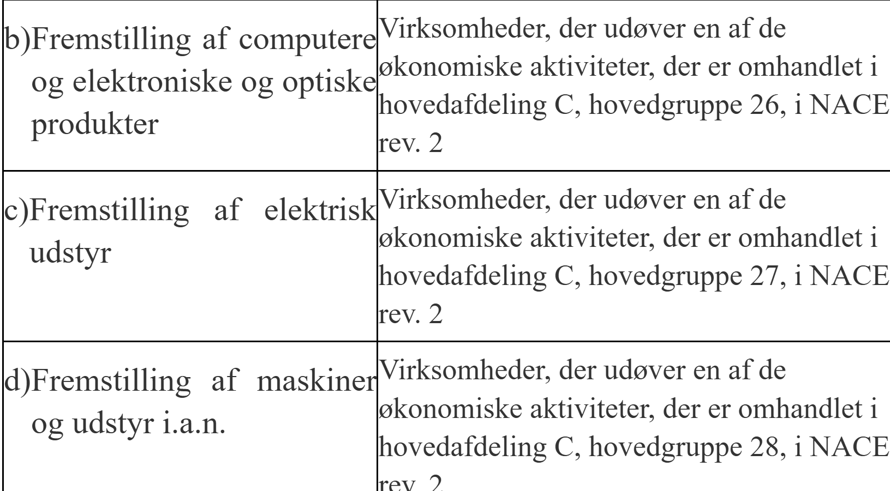
NIS-2 – Hvem er i scope

Slide 21
NIS 2
Danish law in effect 1/7-2025 (in Denmark)
NIS 2 is focused on “organizational” security
i.e. traditional IT/OT security (ISO 27001 and/or IEC 62443, CIS-18, etc.)
Management is accountable – and must receive training in security
Must use a risk based approach to security (goal is to protect important parts of society)
Reporting obligations on incidents (similar to GDPR)
NIS 2 also introduces “supply chain security”
NIS 2 entities need to make sure products/services they use are secure

Slide 22
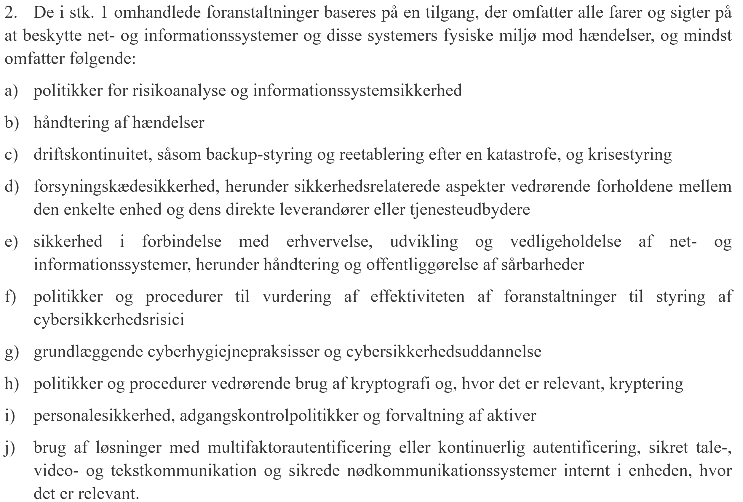
NIS-2 – Kravene (Art. 21)

Slide 23
NIS-2 – Kravene
Ved vurderingen af proportionaliteten af disse foranstaltninger tages der behørigt hensyn til graden af enhedens eksponering for risici, enhedens størrelse og sandsynligheden for hændelser og deres alvor, herunder deres samfundsmæssige og økonomiske indvirkning.

Slide 24
Supply chain security – indirect consequences
We are not in scope, but our customers are:
Requirements are very uncertain
Will customer requirements be organisational or product/service specific?
Will customers require certifications/hard proof or just good arguments?
Notes:
Could the NIS2 requirement become defacto requirements for all companies?

Slide 25

NIS 2 – Good practices for supply chain security
ENISA publication
LINK
3.5.1 Suppliers:
A supplier of products should have processes in place that provide quality products in regards of cybersecurity. As an overview, it can be summarised as follows. A supplier has the infrastructure and organisation relevant for the design, development, manufacturing and delivery of products and components managed by the requirements of ISO/IEC 27001. A secure development process such as IEC 62443-4-1:2018 is deployed, and technical requirements of products and components are set out in IEC 62443-4-2:2019. A quality management system ISO 9001 is implemented to continuously improve the quality.

Slide 26
Produkt regulering

Slide 27

Radio Equipment Directive Delegated Act
RED regulerer radioudstyr
Frekvenser og sendestyrke
En ”let” måde at få cybersikkerhed i IoT
Nye krav trådte i kraft pr. 1/8-2025
”Radio equipment does not harm the network or its functioning nor misuse network resources, thereby causing an unacceptable degradation of service;”
Notes:
https://eur-lex.europa.eu/eli/dir/2014/53/2024-12-28

Slide 28
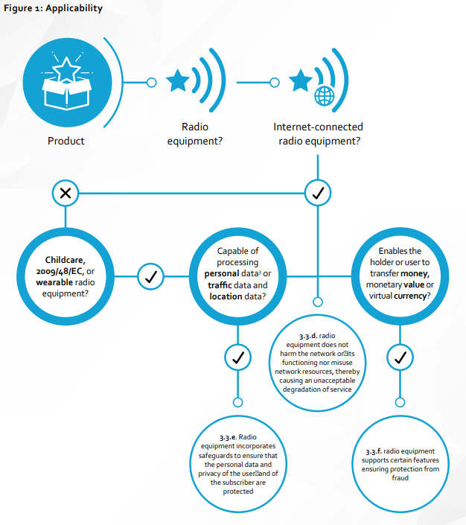

Radio Equipment Directive
Are our products in scope?
Which parts applies to us?
https://orgalim.eu/position-papers/internal-market-common-understanding-term-internet-connected-radio-equipment

Slide 29
Radio Equipment Directive Delegated Act
CEN/CLC hEN 18031-x standards are cited
Alternative to hEN 18031-x self assessment is Notified Body
Notes:
https://eur-lex.europa.eu/eli/dir/2014/53/2024-12-28

Slide 30

All radio (IoT) products now sold are cybersecure
Notes:
Sikkerhed vs. compliance

Slide 31
The Cyber Resilience Act
Article 1:
Subject matter
rules for the making available on the market of products with digital elements to ensure the cybersecurity of such products;
essential cybersecurity requirements for the design, development and production of products with digital elements, and obligations for economic operators in relation to those products with respect to cybersecurity;
essential cybersecurity requirements for the vulnerability handling processes put in place by manufacturers to ensure the cybersecurity of products with digital elements during the time the products are expected to be in use, and obligations for economic operators in relation to those processes;
rules on market surveillance, including monitoring, and enforcement of the rules and requirements referred to in this Article.

Slide 32
The Cyber Resilience Act
Article 2:
Scope
This Regulation applies to products with digital elements made available on the market, the intended purpose or reasonably foreseeable use of which includes a direct or indirect logical or physical data connection to a device or network.
This Regulation does not apply to products with digital elements to which the following Union legal acts apply:
Regulation (EU) 2017/745; (medical devices)
Regulation (EU) 2017/746; (medical devices)
Regulation (EU) 2019/2144. (motor vehicles)
This Regulation does not apply to products with digital elements that have been certified in accordance with Regulation (EU) 2018/1139. (aviation)
The application of this Regulation to products with digital elements covered by other Union rules laying down requirements that address all or some of the risks covered by the essential cybersecurity requirements set out in Annex I may be limited or excluded where:
such limitation or exclusion is consistent with the overall regulatory framework that applies to those products; and
the sectoral rules achieve the same or a higher level of protection as that provided for by this Regulation.

Slide 33

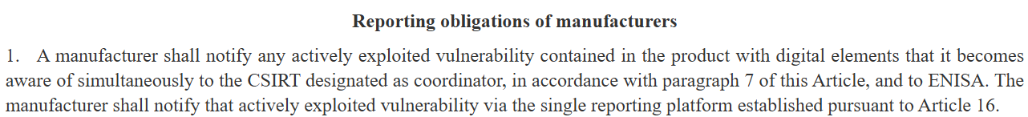
Cyber Resilience Act
Cited in Official Journal of EU
In effect 11th December 2027
Reporting obligations from 11th September 2026:
Still open questions, particular on software:
Open Source Software, Remote Data Processing Service, exact definitions of product type, etc.
Guidance will come at some point
Standardization is trying to interpret as well

Slide 34
The Cyber Resilience Act
Annex III and IV:
Compliance
Basic products
Anything else
Important products
Class I
…
Microcontrollers with security-related functionalities
Smart home general purpose virtual assistants
Smart home products with security functionalities, including smart door locks, …
…
Important products
Class II
Hypervisors and container runtime system
Firewalls, intrusion detection and prevention systems
Tamper-resistant microprocessors
Tamper-resistant microcontrollers
Critical products
Hardware Devices with Security Boxes
Smart meter gateways within smart metering systems…
Smartcards or similar devices, including secure elements

Slide 35
The Cyber Resilience Act
Annex III and IV:
Compliance
Basic products
Module A
Module B+C
Module H
EU Cybersecurity certification scheme
Important products
Class I
Module A (Full hEN)
Module B+C
Module H
EU Cybersecurity certification scheme (AL Substantial)
Important products
Class II
Module B+C
Module H
EU Cybersecurity certification scheme (AL Substantial)
Critical products
EU Cybersecurity certification scheme (AL >= Substantial) for the specific product type
As Class II, if no scheme exists

Slide 36
The Cyber Resilience Act
Annex I:
The requirements
Part 1: Cybersecurity requirements relating to the properties of products with digital elements
Products with digital elements shall be designed, developed and produced in such a way that they ensure an appropriate level of cybersecurity based on the risks.
On the basis of the cybersecurity risk assessment referred to in Article 13(2) and where applicable, products with digital elements shall:
be made available on the market without known exploitable vulnerabilities;
be made available on the market with a secure by default configuration, unless otherwise agreed between manufacturer and business user in relation to a tailor-made product with digital elements, including the possibility to reset the product to its original state;
ensure that vulnerabilities can be addressed through security updates, including, where applicable, through automatic security updates that are installed within an appropriate timeframe enabled as a default setting, with a clear and easy-to-use opt-out mechanism, through the notification of available updates to users, and the option to temporarily postpone them;
ensure protection from unauthorised access by appropriate control mechanisms, including but not limited to authentication, identity or access management systems, and report on possible unauthorised access;

Slide 37
The Cyber Resilience Act
Annex I:
The requirements
protect the confidentiality of stored, transmitted or otherwise processed data, personal or other, such as by encrypting relevant data at rest or in transit by state of the art mechanisms, and by using other technical means;
protect the integrity of stored, transmitted or otherwise processed data, personal or other, commands, programs and configuration against any manipulation or modification not authorised by the user, and report on corruptions;
process only data, personal or other, that are adequate, relevant and limited to what is necessary in relation to the intended purpose of the product with digital elements (data minimisation);
protect the availability of essential and basic functions, also after an incident, including through resilience and mitigation measures against denial-of-service attacks;
minimise the negative impact by the products themselves or connected devices on the availability of services provided by other devices or networks;
be designed, developed and produced to limit attack surfaces, including external interfaces;
be designed, developed and produced to reduce the impact of an incident using appropriate exploitation mitigation mechanisms and techniques;

Slide 38
The Cyber Resilience Act
Annex I:
The requirements
provide security related information by recording and monitoring relevant internal activity, including the access to or modification of data, services or functions, with an opt-out mechanism for the user;
provide the possibility for users to securely and easily remove on a permanent basis all data and settings and, where such data can be transferred to other products or systems, ensure that this is done in a secure manner.;

Slide 39
The Cyber Resilience Act
Annex I:
The requirements
Part 2: Vulnerability handling requirements
Manufacturers of products with digital elements shall:
identify and document vulnerabilities and components contained in products with digital elements, including by drawing up a software bill of materials in a commonly used and machine-readable format covering at the very least the top-level dependencies of the products;
in relation to the risks posed to products with digital elements, address and remediate vulnerabilities without delay, including by providing security updates; where technically feasible, new security updates shall be provided separately from functionality updates;
apply effective and regular tests and reviews of the security of the product with digital elements;
once a security update has been made available, share and publicly disclose information about fixed vulnerabilities, including a description of the vulnerabilities, information allowing users to identify the product with digital elements affected, the impacts of the vulnerabilities, their severity and clear and accessible information helping users to remediate the vulnerabilities; in duly justified cases, where manufacturers consider the security risks of publication to outweigh the security benefits, they may delay making public information regarding a fixed vulnerability until after users have been given the possibility to apply the relevant patch;

Slide 40
The Cyber Resilience Act
Annex I:
The requirements
put in place and enforce a policy on coordinated vulnerability disclosure;
take measures to facilitate the sharing of information about potential vulnerabilities in their product with digital elements as well as in third-party components contained in that product, including by providing a contact address for the reporting of the vulnerabilities discovered in the product with digital elements;
provide for mechanisms to securely distribute updates for products with digital elements to ensure that vulnerabilities are fixed or mitigated in a timely manner and, where applicable for security updates, in an automatic manner;
ensure that, where security updates are available to address identified security issues, they are disseminated without delay and, unless otherwise agreed between a manufacturer and a business user in relation to a tailor-made product with digital elements, free of charge, accompanied by advisory messages providing users with the relevant information, including on potential action to be taken.

Slide 41
Pause + Case

Slide 42
CASE – Diskussion i grupperne
Hvilke love og reguleringer bør virksomheden forholde sig til?
Er nogle love mindre relevante?
Er der nogle aspekter i lovene særligt relevante for virksomheden?
Hvad bør virksomheden igangsætte af aktiviteter?

Slide 43
Standarder og best practices

Slide 44
ISO 27000 Familien
Ikke “bare” ISO 27001
Knapt 100 standarder i serien
ISO 27000: Overblik og ordbog
ISO 27001: Ledelsessystem
ISO 27002: Sikkerheds foranstaltninger
ISO 27005: IT Sikkerheds risikostyring
ISO 27017: Cloud sikkerhed
ISO 27018: Persondata i cloud tjenester

Slide 45
ISO 27001
Ledelsessystemet
Lille og overskuelig (10 sider indhold)
Politikker omkring sikkerhed, f.eks.
Hvordan involveres ledelsen?
Hvordan forbedrer vi os?
Ingen tekniske foranstaltninger
ISO 27001 peger på indhold i ISO 27002

Slide 46
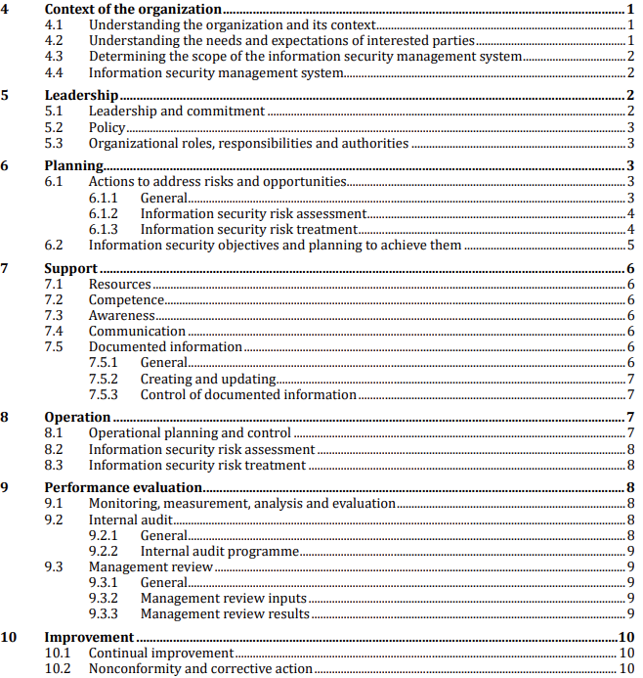
ISO 27001

Slide 47
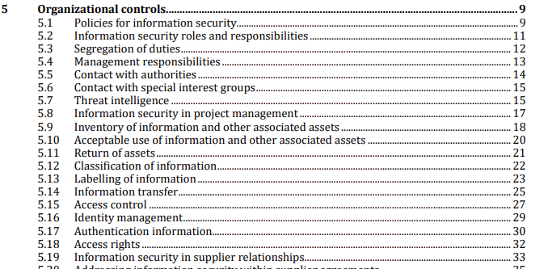
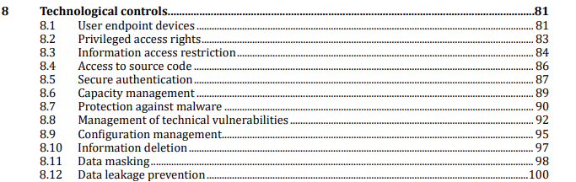
ISO 27002
De tekniske foranstaltninger (130 sider)

Slide 48
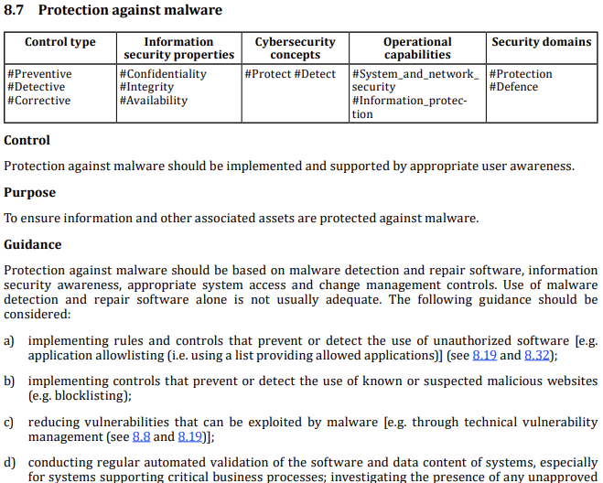
ISO 27002

Slide 49
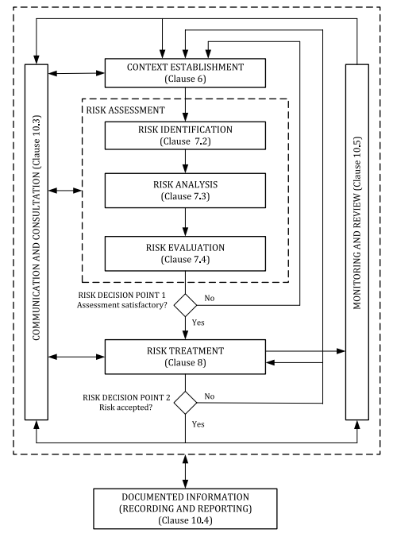
ISO 27005 Risikostyring

Slide 50
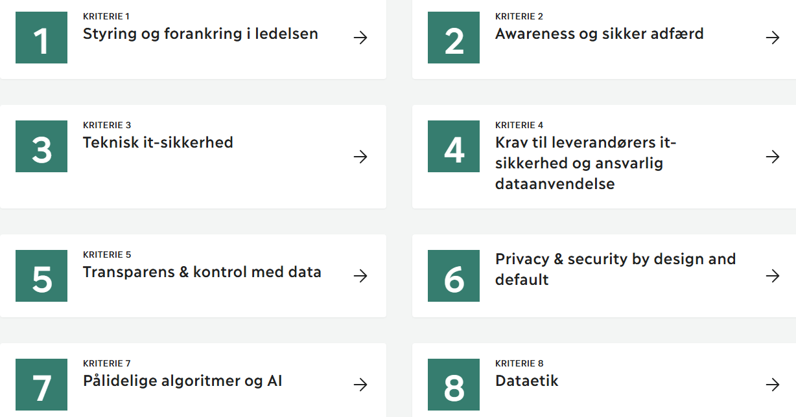
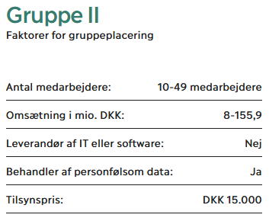
D-Mærket
https://www.d-maerket.dk/
Sponseret af Industriens Fond
En mærkningsordning
Ikke en standard
Gratis selvevaluering – Tilsyn/mærket koster

Slide 51
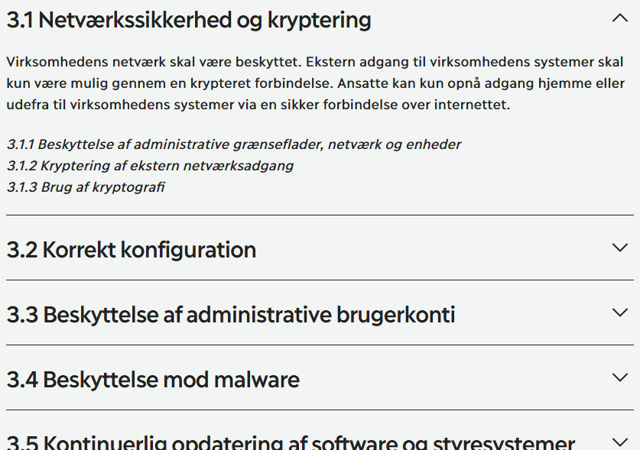
D-Mærket

Slide 52
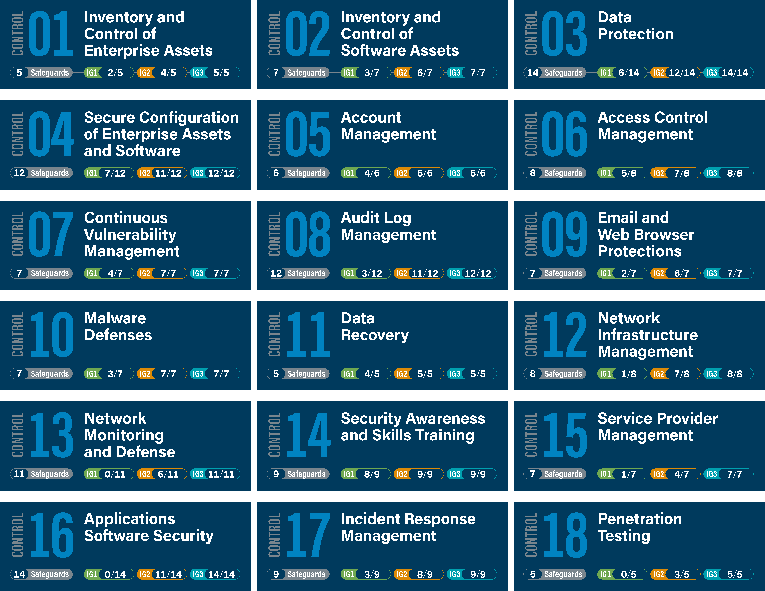
CIS-18
CIS Critical Security Controls (v8)
Kun foranstaltninger, minder om ISO 27002
3 “Implementation Groups”
IG1: Begrænset IT
IG2: Dedikeret IT personale
IG3: Dedikeret IT sikkerheds personale

Slide 53
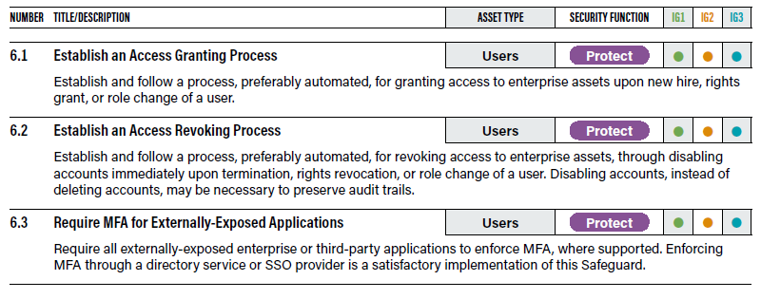
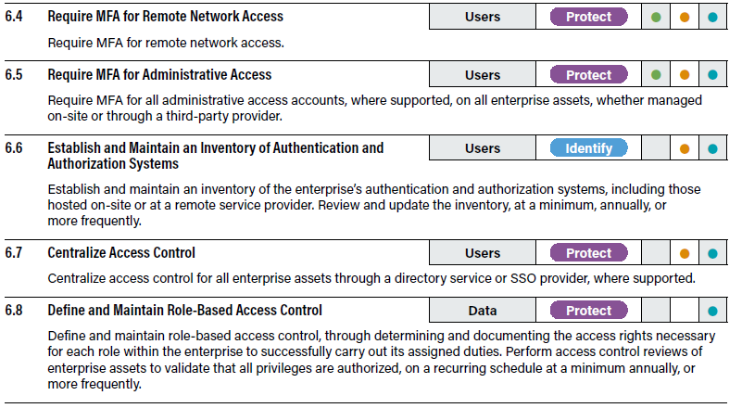
CIS-18

Slide 54
OWASP – Open WorldWide Application Security Project
Har mange (forskellige) resourcer
Fokus er på “application security”
Top 10 most critical… WebApp/IoT/LLM/API
Application Security Verification Standard (ASVS)
Mobile ASVS (og testing guide)
Software Assurance Maturity Model (SAMM)
Mange gratis resourcer
Men nogle projekter vedligeholdes ikke længere ☹

Slide 55
OWASP - Værktøjer
Risk Rating Methodology
Dependency checker
Zed Attack Proxy (opkøbt af Checkmarx)
Juice Shop (usikker webapp)

Slide 56
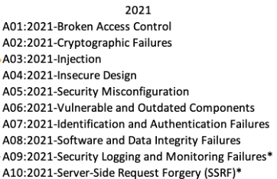
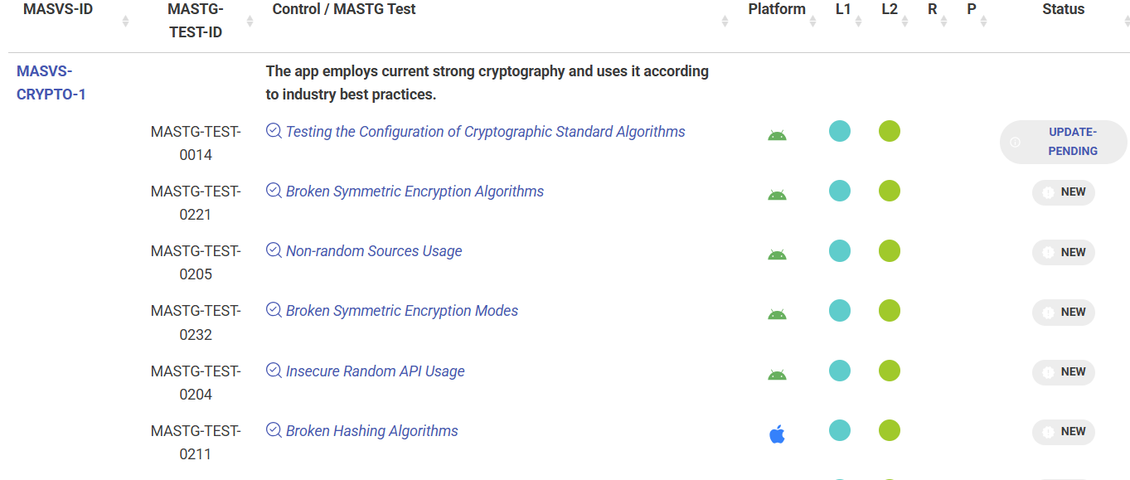
OWASP – App sec
”Top 10 most critical”
Sårbarheder i applikationer
MASVS:
24 foranstaltninger

Slide 57
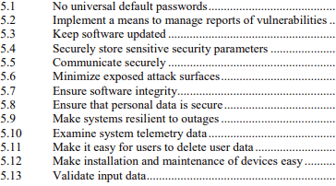
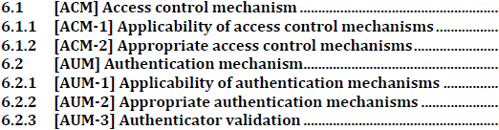
”Produkt standarderne”
”Rigtige” standarder til at dokumentere cybersikkerhed
ETSI EN 303 645: Consumer IoT
EN 18031- 1/2/3: Radio udstyr
IEC 62443-4- 1/2: Komponenter i OT systemer
+ en hel del kommer ifbm. CRA

Slide 58
Pause + Case

Slide 59
CASE – Diskussion i grupperne
Hvilke standarder kunne være særligt relevante for virksomheden?
Hvordan kan virksomheden bruge standarderne?
Hvad bør virksomheden igangsætte af aktiviteter?

Slide 60
Agenda
Tidspunkt | Emne | Format
8.30-8.45 | Introduktion til “Cyber lovgivning” Introduktion til standarder | Præsentation
8.45-9.30 | Lovgivning GDPR og NIS-2 RED DA og CRA | Præsentation
9.30-10.15 | Pause + Øvelse / case | Workshop
10.15-11.15 | Standarder og best practices 27000-familien D-mærket, CIS-18 og OWASP Produkt standarderne | Præsentation
11.15-12.00 | Pause + Øvelse / case | Workshop
12.00-13.00 | Frokost
13.00-13.30 | Beredskabsplaner | Præsentation
13.30-13.45 | Øvelse / case | Workshop
13.45-14.00 | Closing remarks | Discussion

Slide 61
(IT-)Beredskabsplaner

Slide 62
It-beredskabsplan
En IT-beredskabsplan indeholder instruktioner, anbefalinger og tiltag med henblik på at genstarte IT-systemer og -services, efter at en uventet hændelse direkte eller indirekte har forhindret normal udførelse af processer.
Nøglekomponenter i en beredskabsplan:
Risikovurdering
Incident Response
Kommunikationsplan
Test og træning

Slide 63
Hvorfor?
Muliggør hurtig og effektiv reaktion på hændelser
Reducere skaden fra hændelser (men reducere ikke sandsynligheden for at de sker)
Identificerer behandler huller i ens responsevner – inden hændelsen sker

Slide 64
Hvordan?
Der er mange måder
Strukturer efter behov, evne og setup
Brug evt eksisterende rammeværk som
ISO/IEC 27035-2-2023
NIST SP 800-61
Tag gældende lovgivning med

Slide 65
Overordnet struktur
Forberedelse
Udarbejdelse
Implementation
(risikovurdering)
(dokumentation)
(test og træning)

Slide 66
Forberedelse og forudsætninger
Systemoverblik (inventor af alle aktiver)
Vurdering af hvert aktiv, prioritering af aktiver og forventinger til responstid
BIA – Business Impact Analysis
RTO – Recovery Time Objective
RPO – Recovery Point Objective
Risikovurdering
Notes:
RPO: f.eks. 4 timers data
RTO: f.eks. 1 dags nedetid

Slide 67
Risikovurdering og beredskabs-planer
Risiko er sandsynlighed kombineret med konsekvens
Beredskabsplaner reducere konsekvensen men ikke sandsynlighed
Baseret på risiko og prioritet:
Udarbejd playbooks/operationelle handlingsplaner
Implementer detektionsmekanismer
Prioriter træning og dokumentation

Slide 68
Terminologi
Operationskapacitet
100%
Incident
BCP
Full remediation
(cant be guaranteed)
RPO
DR
20%
Incident Response
RTO
Time

Slide 69
Incident Response-cyklus
Before
1. Preparation: Creation and maintenance of documentation. Performing training, tests, backups and generating logs.
During
2. Identification and response: Activation of the IR plan
After
6. Post-incident assessment: Clean-up, evaluation, identification and implementing improvements.
3. Containment: stop the incident
4. Analysis: Understand the incident and plan remediation
5. Remediation: execute restore operations
Notes:
Der er mange standarder. Nogle burger 5, 6 eller 7 faser.
Jeg foretrækker at bruge 6
Groft sagt, kan disse 6 inddeles I tre typer: før, under og efter en hændelse.
Det er vigtigt at understrege, at disse 6 faser ikke er 100% sekventielle, særligt “under” faserne, 2, 3, 4 og 5:
Disse fire faser kører med interne ‘feedback loops’. Containment startes f.eks ofte op allerede imens fase 2 er I gang og analysen forløber ofte parallelt med de andre aktiviteter.
Vigtig point: IR planlægning er en livscyklus: Post-incident aktiviteter skal munde ud i tiltag og aktiviteter som indgår i fase 1 som forberedelse til næste hændelse.
IR arbejder er derfor IKKE en engangsøvelse. Undgå at lav planerne, øve dem én gang, og så placere dem i en skuffe uden at se på dem igen.
NIS2 kræver hændelses indberetning

Slide 70
IR-team
IR-manager
Har det endelige ansvar
Koordinerer teamet
Rapporterer til management
Incident Responders
‘First line detection’ SOC/SIEM medarbejderer
Tekniske specialister
Netwærk/
Systemadministratorer
IT-support
Ikke-teknisk personale
Jurister
PR/HR
Ledelse og direktion
Infrastruktur
IR-teamet
Notes:
Not all roles are relevant for all incident types
Some roles are optional, e.g. forensic analysts may be brought from external consultants, IR team may be outsourced. Not all orgs. Has dedicated PR and Legal counsel.
Not all organisations will have different staff members for each role – some will have multiple roles on the same IR members.

Slide 71
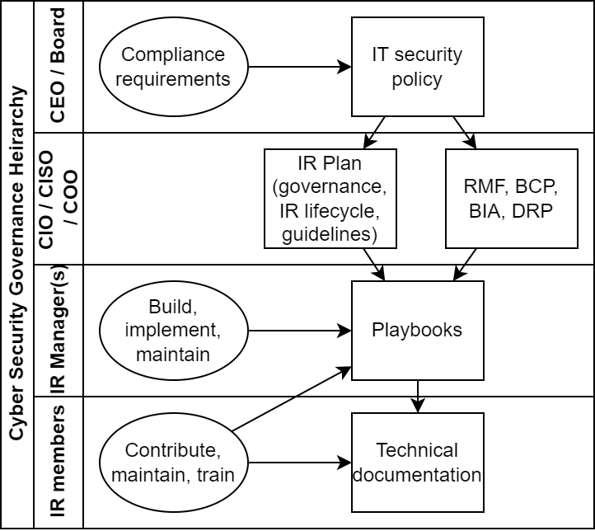
Dokumentejerskab

Slide 72
Business Continuity Plan (Nødplan)
Hvordan sikrer man at forretningen kan fortsætte under hændelsen?
Detaljeret beskrivelse af strategier og konkrete handlinger der vedligeholder driften af specifikke systemer
Hvad skal vi gøre?
Hvad skal vi have?
Fortroligt dokument
‘Stand-alone’ dokument
Notes:
Backup
Redundancy
How do they contact their byers and suppliers?
Accessibility – you need it because one or more of your critical systems are down, so you need to be able to find it without access to those systems.
Notice that this plan is likely to contain confidential material, as it might guide an attacker to hit you even harder.
There is a template for this

Slide 73
Disaster Recovery Plan (Reetablerings-plan)
Hvordan genetablerer man driften efter en hændelse?
Detaljeret beskrivelse af strategier og konkrete handlinger der genopretter driften
Skal garantere RTO
Fortroligt dokument
‘Stand-alone’ dokument
Notes:
How is the systems restored after the crises
Confidential
Preferably stand alone
Reasonably accessible
Should be doable within the time assessed in the risk analysis

Slide 74
Playbooks
Operationelle handlingsplaner til konkrete hændelser
E.g. phishing, malware, ransomware, DDoS, etc.
Udfordringer:
Hvor mange og hvilke playbooks?
Hvor mange detaljer i playbooks kontra andre dokumenter?

Slide 75
Beredskabsplan
Hoveddokument der beskriver
Organisation
Aktiveringsomstændigheder og eskalering
Generelle handlingsplaner
IR-cyklus
Lister over individuelle referencer
Systemoverblik og risikovurderinger
Handlingsplaner (BCP/DR)
Playbooks
Evaluering
Test og træning
Notes:
Eskalering er hierakiet/rækkefølgen på kommunikation så hændelse bliver kommunikeret til de rette mennesker (dem der skal håndtere, rapportere og have ansvar)

Slide 76
Eksempel – Beredskabsplans-template fra KL
1. Beredskabsorganisation
2. Aktivering og eskalering
3. Evaluering af beredskab
4. Vedligeholdelse af beredskabsplanen
5. Bilag
Notes:
2.1 Roller og ansvar
2.2 Kontaktlister
3.1 Eskalering
3.2 Kommunikation
3.3 Nødplaner for systemer og deres forretningsunderstøttelse
3.4 Retablering
5.1 Distribution og opbevaring
6.1 Kontaktlister Bilag A
6.2 Overblik over nødplaner Bilag B
6.3 Nødplan Bilag Bx.x
6.4 Action cards Bilag C
6.5 Beredskabslog Bilag D

Slide 77
Eksempel – Nødplanstemplate fra KL
1. Indledning og systembeskrivelse
2. Kontaktpersoner
3. Nødplan ved nedbrud
4. Procedurer, hvis systemet ikke er til rådighed
5. Plan for tilbagevenden til normal situation

Slide 78
Test og træning
Rollespil
Saml relevante medarbejdere og afprøv en konkret hændelse
Faciliter dialog og kritiske spørgsmål
Bemærk, at man ikke kan lave det på produktionsmiljøer og må nøjes med ‘skrivebordstest’
Afprøv backupsystemer
Sikr at alt beredskabsmateriale er tilgængeligt selv under kritiske hændelser

Slide 79
Yderligere materiale
Sikker Digital https://www.sikkerdigital.dk/virksomhed/leder/it-sikkerhedspolitik-og-beredskabsplan
KL https://www.kl.dk/videncenter/viden-og-vaerktoejer/databeskyttelse-cyber-og-informationssikkerhed/cyber-og-informationssikkerhed/beredskab-for-cyber-og-informationssikkerhed

Slide 80
Diskussionspørgsmål

Slide 81
XYZ Thermo
Hvilke systemer er mest kritiske at få op at køre igen efter en større hændelse?
Hvilke typer hændelser bør XYZ Thermo have playbooks for?
Hvad bør RTO være for cloud-backend, som styrer varmepumperne?
Hvad er en realistisk RPO for telemetridata fra enheder?

